Slide 1
Sprint 2
PerlSquad

Slide 2
Project Requirement/Overview Clarifications:
Computer game to be used by grad students to be customized and used in the classroom
Focus is on “science literacy” and learning/reinforcing knowledge of biomes in students
User base:
Educators
(not grad) students

Slide 3
Sprint 2 Goals
Implement Analytics
Mini-game “feedback screen” + other improvements
Broaden Manifest
More robust customization

Slide 4
Analytics
Segment
Easily send data from the app and store it in the cloud
Keen.IO
Customizable Dashboard for Visualizations

Slide 5
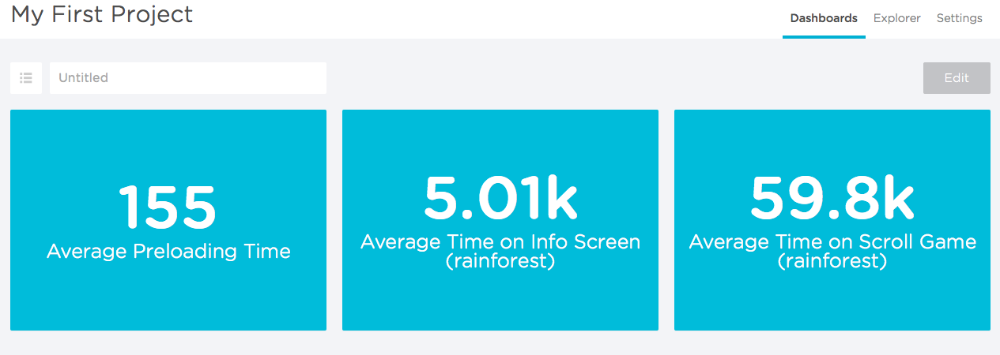
Analytics

Slide 6
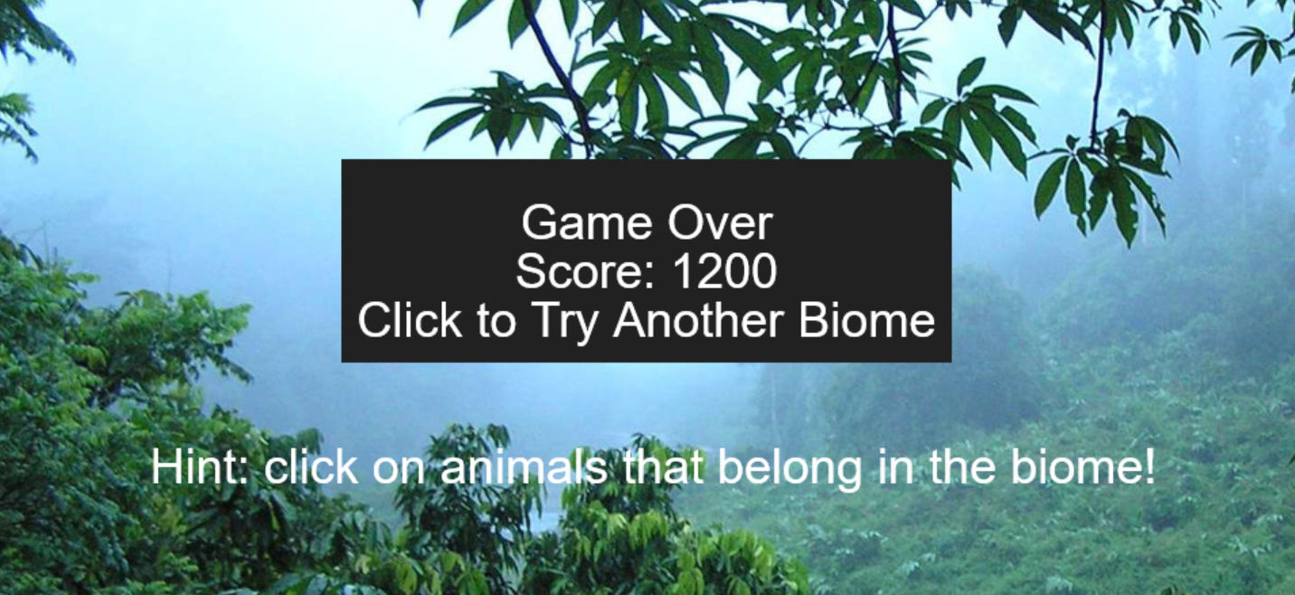
Mini-game improvements

Slide 7
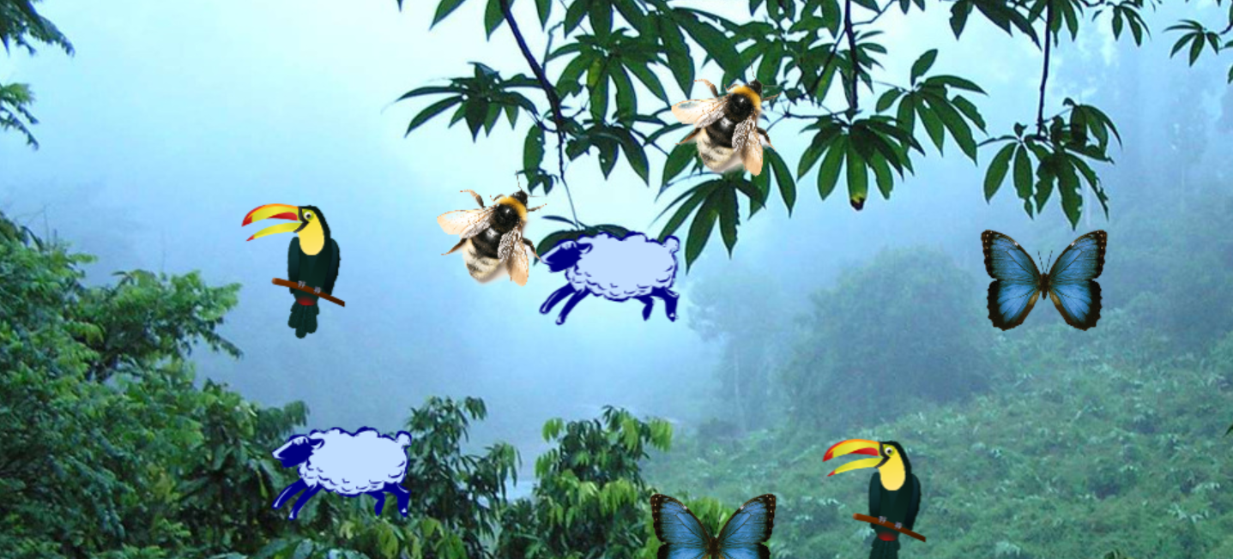
Mini-game improvements

Slide 8
Successes & Roadblocks
Did not have time to implement interworking customization options with mini-game (adapt to different biomes, user selected images)
Added simple feedback hint if player clicks on too many of the “wrong” animal
Meant to add more to the game, but had less time to work on this project since last sprint than I anticipated
Will work on generalization of JS for next sprint

Slide 9
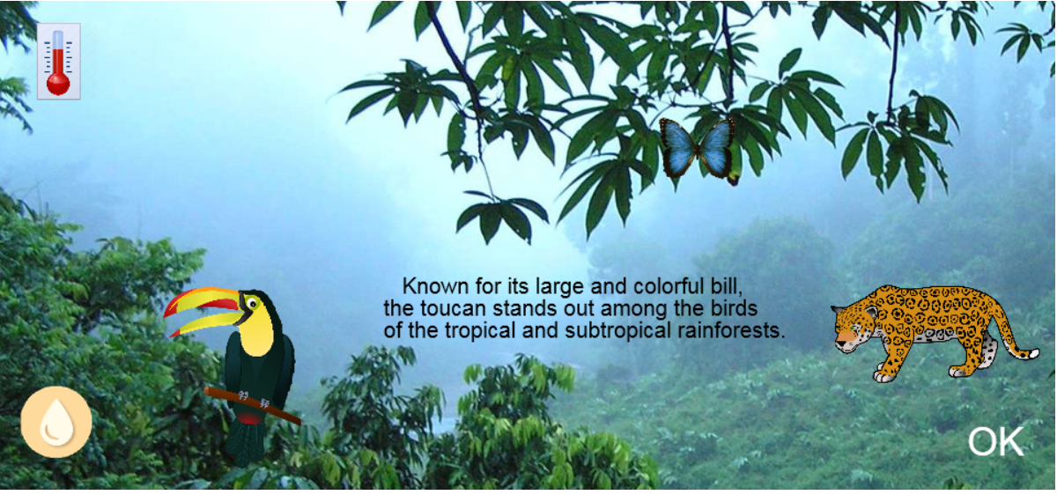
Hover-Over Info Screen

Slide 10
Successes & Roadblocks:
Replaced scavenger hunt page with Info screen - client felt it would encourage students to think for themselves and would draw more attention to biome objects.
Added hover-over events to display and hide text.
Finished generalizing template for biomes’ objects
Some things such as object position cannot be generalized, so will need an alternate way to assign coordinates for biome customization

Slide 11
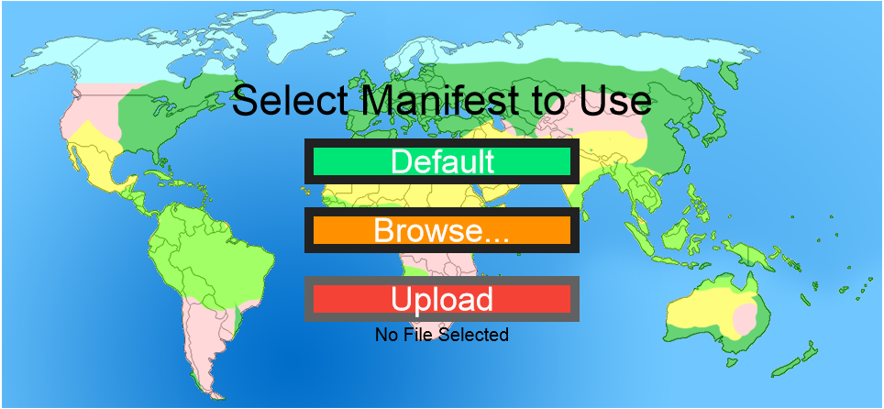
Flexible manifest

Slide 12
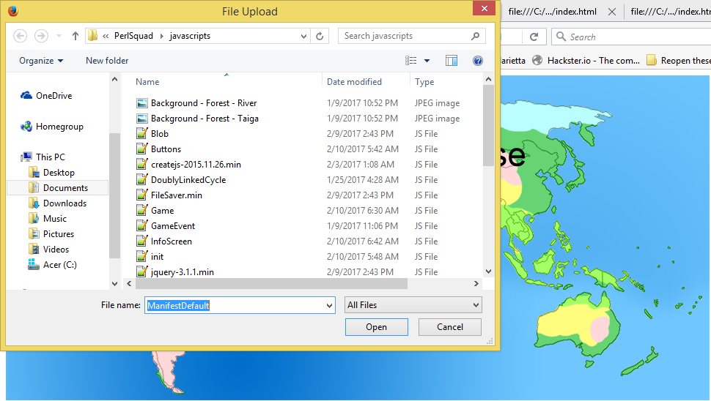
Flexible Manifest (Cont.)

Slide 13
Successes & Roadblocks:
Enabled browsing to upload manifest file. Now, once a custom manifest is downloaded, it can be put into any folder the user wants and reloaded into the game later.
Custom manifests can also be loaded into the game for adding images/editing current images/text.
Manifests are entirely text-based now.
Still had to hardcode default manifest into a string and had to make a special function for handling image description text.
Unfortunately, didn’t have enough time to hammer out the actual editing portion. Javascript is not the best programming language for text modifications.

Slide 14
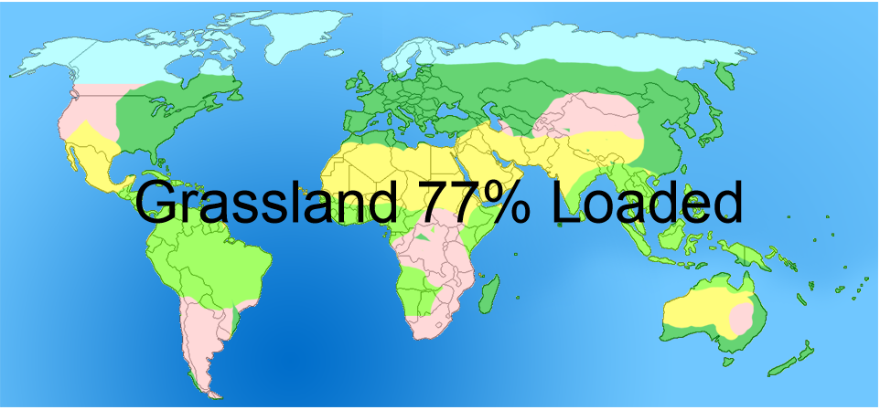
Enhanced Preloading

Slide 15
Successes & Roadblocks:
Preloading split into segments based on biome in order to avoid synchronous loading errors.
Loading screen now displays what portion of the assets is being loaded
Took some trial and error to figure out how to configure the preloading to avoid overcomplicating things.

Slide 16
The Future
Finishing add and edit features
Associate biomes with their images
Add backend for customization
Expand the game manifest to include more images/text and preload those as well
Start working on editor for each section of game.

